Slide 1

Machine Learning, Data Science and Decision Lab
Structured Learning & Decision Making for Medical Informatics
Onur Atan
August, 2018

Slide 2
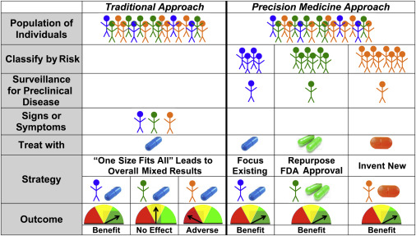
Motivation

Slide 3
Motivation: RCTs and Observational Study
Randomized Controlled Trials (RCTs)
Gold standard to determine the efficacy of a treatment.
Recruit patients, assign them to treatment and control group, and test hypothesis.
Observational Studies
The data generated by clinicians performing treatments on real patients.
No control group, no randomization.
RCTs and observational studies are complementary to each other:
Observational studies are great way to follow the success of a new drug after approval.
RCTs can be designed to test hypothesis extracted from observational studies.
Efficient learning from RCTs and observational studies

Slide 4
Research Agenda
Global Bandits
- Online decision making from finite set of treatments assuming dependence between the actions
- Appeared in AISTATS 2015 and IEEE TNNLS
Counterfactual Policy Optimization
- Learning to make decision from logged data of feature, treatment, and outcome.
- Appeared in AAAI, 2018, and under review on Machine Learning Journal
Online Decision Making with Costly Information
-Online decision making to select from costly information sources and to recommend treatments.
- submitted
Sequential Patient Allocation on RCTs
-Sequential decision making for patient recruitments to optimize the learning objective.
- To be submitted

Slide 5
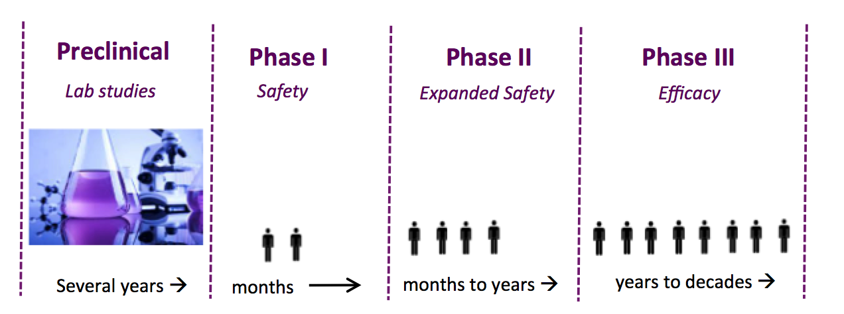
Randomized Controlled Trials (RCTs)
RCTs are GOLD standard for evaluating new drugs & treatments
The average costs for trials in vital therapeutic areas such as respiratory system, anesthesia and oncology are $115.3M, $105.4M, $78.6M.
They take several years to conduct trials.

Slide 6
Patient Recruitment in RCTs
Most common approach: Repeated Fair Coin Flipping
It would be the best choice if the patients are recruited at once. But
- Impractical
- Unnecessary
We can use what’ve learned to recruit the next set of patients.
We design an adaptive patient recruitment/allocation algorithm.

Slide 7
What is done in the literature ?
Adaptive biased coin randomization: To balance group sizes.
Covariate-adaptive randomization: To minimize the covariate imbalance.
Outcome-adaptive randomization: To improve patient benefit
- Multi-armed Bandits (MABs) [1,2] : An improved patient benefit, but less learning power
- [3]: A variant of MABs to improve their learning power
We focus on sequential patient recruitment to improve learning.
[1] Lai, T.L. and Robbins, H., 1985. Asymptotically efficient adaptive allocation rules. Advances in applied mathematics, 6(1), pp.4-22.
[2] Auer, P., Cesa-Bianchi, N. and Fischer, P., 2002. Finite-time analysis of the multiarmed bandit problem. Machine learning, 47(2-3), pp.235-256.
[3] Villar, S.S., Bowden, J. and Wason, J., 2015. Multi-armed bandit models for the optimal design of clinical trials: benefits and challenges. Statistical science: a review journal of the Institute of Mathematical Statistics, 30(2), p.199.

Slide 8
Design of RCTs
Designer of trial sets:
Patient Budget N
Time Budget T
Primary outcome of interest
Set of patient subgroups of interest
Designer can recruit N patients over K = T/ steps where is the time required to observe the primary outcome
An example of actual RCT [4]:
Patient budget : 838, outcome: 30 day mortality, study length: 36 months
Patients can be recruited in monthly basis.
[4] Hébert, P.C., Wells, G., Blajchman, M.A., Marshall, J., Martin, C., Pagliarello, G., Tweeddale, M., Schweitzer, I., Yetisir, E. and Transfusion Requirements in Critical Care Investigators for the Canadian Critical Care Trials Group, 1999. A multicenter, randomized, controlled clinical trial of transfusion requirements in critical care. New England Journal of Medicine, 340(6), pp.409-417.

Slide 9
Outcome Model: Exponential Family Distributions
Define and . The single-parameter exponential family with sufficient statistic G and parameterization relative to h is dominated family of distributions by the following densities:
Properties: , .
Examples: Bernoulli, Poisson, Exponential distribution
Jeffrey’s prior on the parameter based on outcomes :

Slide 10
Definitions
Set of subgroups:
Action set (treatment and control actions):
Outcome parameter of (x,y):
Treatment Effect (TE) of subgroup x is expected difference between treatment and control action
Efficacious Label (EL) of subgroup x is 1 if expected outcome of treatment action improves expected outcome of control action by pre-specified τ:

Slide 11
Posterior expectations for TE and EL
Having recruited n patients in stage k, posterior distributions given the filtration are given by:
where is the cumulative sufficient statistics.
where is number of samples.
Then, conditional expectations are given by

Slide 12
Learning Objective for RCTs
Objective 1: Estimating the treatment effects of subgroups. The metric we use in this case is the total posterior variance of TE:
Objective 2: Estimating whether treatment action is efficient with respect to control action . The metric we use in this case is the total misclassification error:

Slide 13
Markov Decision Process (MDP) Formulation
State vector: with .
Action vector: with M being number of patients to recruit, and where is the number of patients from subgroup x that is assigned to treatment group y.
Based on outcome observations , define
State transition: Based on Bayesian update, .

Slide 14
Markov Decision Process (MDP) Formulation (Continued)
Reward function: the expected improvements in the errors by taking an action at a particular state:
Learning objective: An allocation policy to optimize:

Slide 15
Dynamic Programming Solution
Optimal value function at stage K:
Q-function at stage k:
Optimal value function is given by:
An action a is optimal if and only if .
DP solution is NOT TRACTABLE for even a mid-size trial because state space is containing all possible posterior distributions, action space is containing all possible way of patient recruitments.
My contribution is an approximate, tractable algorithm that achieves more efficient learning power.

Slide 16
Idea of Optimistic Knowledge Gradient (Opt-KG)
S1
S2
S3
S4
0.5
In favor of control
In favor of treatment
The maximum gain in the misclassification error by sampling from a subgroup

Slide 17
Experimental Setting
We use two types of primary outcomes: time to adverse event (modeled as an Exponential distribution), an adverse event indication (modeled as a Bernoulli distribution)
Two simulation setting:
Exponential distribution, TE estimation
Bernoulli distribution, EL classification
Metrics: RMSE for TE estimation, total error for EL classification
We report average metrics over 1000 experiments.

Slide 18
Improvements with respect to UA for EL classification

Slide 19
Improvements with respect to UA for TE estimation
Experiments on Exponential Model with and varying for 1000 patients.
The improvement score of Opt-KG with respect to UA is larger when standard deviation of treatment and control differs from each other.

Slide 20
Misclassification error for different patient budget
Experiments on Bernoulli outcomes for and for τ=0.1
Thompson Sampling (TS) aims to maximize patient benefit. Hence,
  Estimation error on “poor” action is large.
  Slower convergence.
All algorithms will converge if there was infinite patient budget.
Our improvement is achieved by sampling more patients to subgroups with smaller gaps.

Slide 21
Recruiting M patients at a time
Experiments on Bernoulli outcomes for and for τ=0.1
M | 10 | 25 | 50 | 100 | 250 | 500
Opt-KG | 0.052 | 0.051 | 0.054 | 0.059 | 0.065 | 0.068
Uniform | 0.093 | 0.092 | 0.095 | 0.096 | 0.092 | 0.094
Table: Misclassification error for different M
The misclassification error is the same for small values of M. If M is large, then algorithm has less flexibility to recruit patients, hence performance drops.

Slide 22
Future Work on RCTs
Identifying the subgroups from patient features.
Non-homogeneous costs for recruiting patients from different subgroups.

Slide 23
Observational Studies vs RCTs
Randomized Clinical trials
are time-consuming & costly,
exhibit small data.
Observational data
easy to obtain,
exhibit larger data.
Can we learn personalized treatments from observational data ?

Slide 24
Neyman-Rubin Causal Model
Each patient i is associated with feature vector
Treatment alternatives:
Potential outcomes:
Observational data:
Personalized treatment policy:
Policy value:

Slide 25
Main Assumptions
Unconfoundedness: Potential outcomes are independent of the treatment performed given the feature vector: A.
⊥
Overlap: There is a non-zero probability that each patient receiving different treatment alternatives.
These assumptions allow us to infer the outcomes of counterfactual actions

Slide 26
Difference between Supervised and Off-Policy Learning
Only the outcome of the treatment actually performed is observed: Partial label
Treatments are selected by clinicians (experts) based on features: Selection bias
Example: Simpson’s Paradox
 | Overall | Small stones | Large stones
Open Surgery | 78% (273/350) | 93% (81/87) | 73% (192/263)
Percutaneous Nephrolithotomy | 83% (289/350) | 87% (234/270) | 69% (55/80)
Table. Success rate of treatments on large and small stone patients
Large feature and action space
The interactions between features and treatments are not known

Slide 27
Main Objectives: ITE Estimation, Policy Optimization (PO)
Two different objectives: ITE estimation, Policy Optimization (PO)
ITE problem: estimate the expected difference between treatment and control outcomes given feature vector.
Policy Optimization (PO): find a policy mapping features to actions that maximizes the expected outcomes.
PO is easier than ITE – one can turn ITE into action recommendation but not the other way around. But ITE literature mostly focuses on problems with 2 treatment alternatives.

Slide 28
Related Work
Literature
Propensities known
Objective
Actions
Solution
Shalit (2017)
NO
ITE
2
Representation balancing
Alaa & Schaar (2017)
NO
ITE
2
Risk based empirical Bayes
Swaminathan (2015)
YES
PO
> 2
IPS re-weighting
Ours
NO
PO
> 2
Representation balancing
Our work is different than ITE/CATE estimation because:
Ours is learning probabilities over actions (policy) to learn best actions
We have NO restrictions on number of actions
Our work is different than existing work in Policy Optimization because:
NO knowledge about logging policy is assumed to be known.
Swaminathan (2015) uses the inverse propensities to handle the bias, but ours uses domain adaption to handle the bias.

Slide 29
Definitions
Representation function:
Hypothesis class:
Source distribution: on the samples in observational data
Target distribution: on the samples where follows the same marginal distribution in observational data, Q is generated independently from multinomial distribution with probabilities 1/k.
Source and target value functions: for

Slide 30
Counterfactual Estimation Bounds
Target value is unbiased:
The bias of the source value: where is H-divergence between source and target.
Monte-Carlo estimator :
The estimation bound:
Counterfactual Policy Optimization:

Slide 31
DACPOL Diagram
Representation Layer
Policy Layer
Source data
(X, A, Y)
…
Policy loss
(Z,A,Y)
…
Target data
(X, Q)
(Z,Q)
Gradient Reversal
…
Domain loss
Domain Layer
Figure. Domain Adversarial Neural Network model based on [Ganin, 2016]

Slide 32
DACPOL Components
Input: where .
Representation layer: maps features to representations
Policy layer: maps representations to policy
Domain layer: maps representations to probability of data being from target.
Reversal layer: reverse gradients of domain loss in backward propagation in order to learn representations that are indifferent between source and target.

Slide 33
Experiments on Breast Cancer Dataset
10000 records of breast cancer patients, 6 chemotherapy regimens.
The outcomes for these regimens are derived based on 32 references from PubMed Clinical Queries
Artificial bias is generated in the following way: (i) generate
(ii) generate
(iii) Set
Loss is defined as the fraction of times a suboptimal action is recommended.

Slide 34
Experiments: Performance Comparison
Algorithms compared:
POEM: optimizes the convex combination of IPS mean and variance estimates.
DACPOL(0): Our algorithm with λ=0.
IPS: optimizes the IPS mean estimate.
Algorithm | Loss
DACPOL | 0.292±0.006
DACPOL(0) | 0.321±0.006
POEM | 0.394±0.004
IPS | 0.397±0.005

Slide 35
Experiments: Domain vs Policy Loss
As λ increases, the representations become balanced, and the loss of DACPOL reaches a minimum. If we increase λ beyond that point, representations become unbalanced, and the loss of DACPOL increases again.

Slide 36
Experiments: Selection bias
As the selection bias increases, domain adversarial training becomes more efficient, and hence the improvement of DACPOL over DACPOL(0) increases.

Slide 37
Global Bandits
Multi-armed bandit model with K treatments:
Assuming a single-parameter model for treatment outcomes.
Goal: An online algorithm that maximizes cumulative outcome.
My contribution:
A greedy algorithm that achieves a bounded parameter dependent regret.
An improved algorithm that achieves bounded parameter dependent regret and worst-case regret.
A matching lower bound

Slide 38
Online Decision Making with Costly Information
Multi-armed bandit model with K treatments and D information sources :
It is costly to observe the information from the sources.
Goal: An algorithm that maximizes cumulative outcome minus cost of information.
My contribution:
Formalized the costly decision-making problem as 2-step MDP (containing information and treatment stages .)
An algorithm that learns and selects the information sources, and treatments based on observed information to maximize cumulative gain.

Slide 39
Conclusion
Learning personalized medicine from RCTs and observational data
Efficient design of RCTs using MDP
Off-policy learning using domain-adversarial neural networks
Future work on precision medicine
Learning combination of treatments/dosages
Learning treatments from time-series patient data

